Slide 1
Internet of Everything Practical

Slide 2
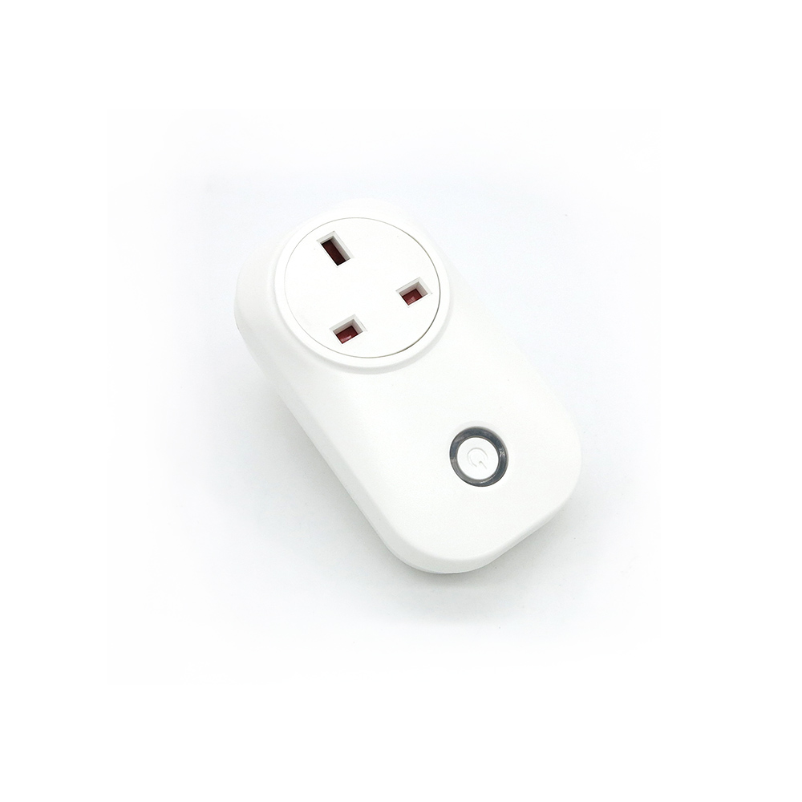
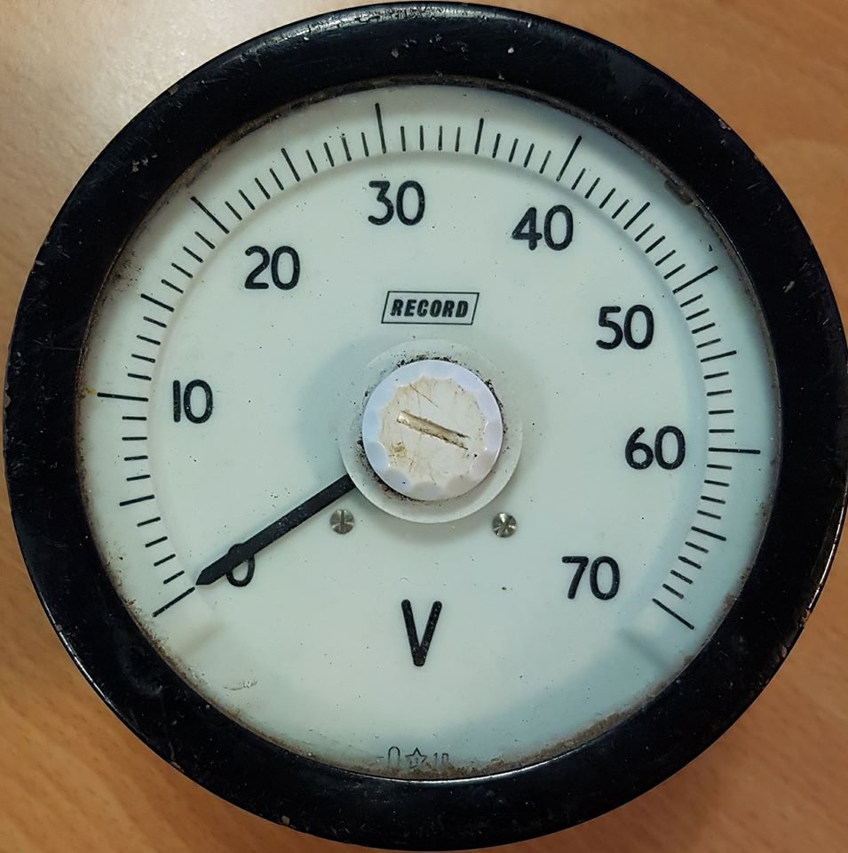
Objectives
Understand how messages can be sent between internet connected things
Construct an #IOT sensor
Write and compile software for the sensor
Send a message to one of the #IOT connected devices

Slide 3
MQTT (Message Queue TelemeTry)
Protocol to send simple messages around the internet
Machine 2 Machine (M2M)
Send messages with a TOPIC
Pub-Sub Process
One or more things publish a message to a “TOPIC”
One or more things subscribe to that “TOPIC”, then get a copy of the message every time one is published

Slide 4
Internet
MQTT
Subscribe Message
Actuator Thing
Sensor Thing
MQTT
Publish Message
MQTT
Publish Message
MQTT
Subscribe Message
MQTT Broker

Slide 5
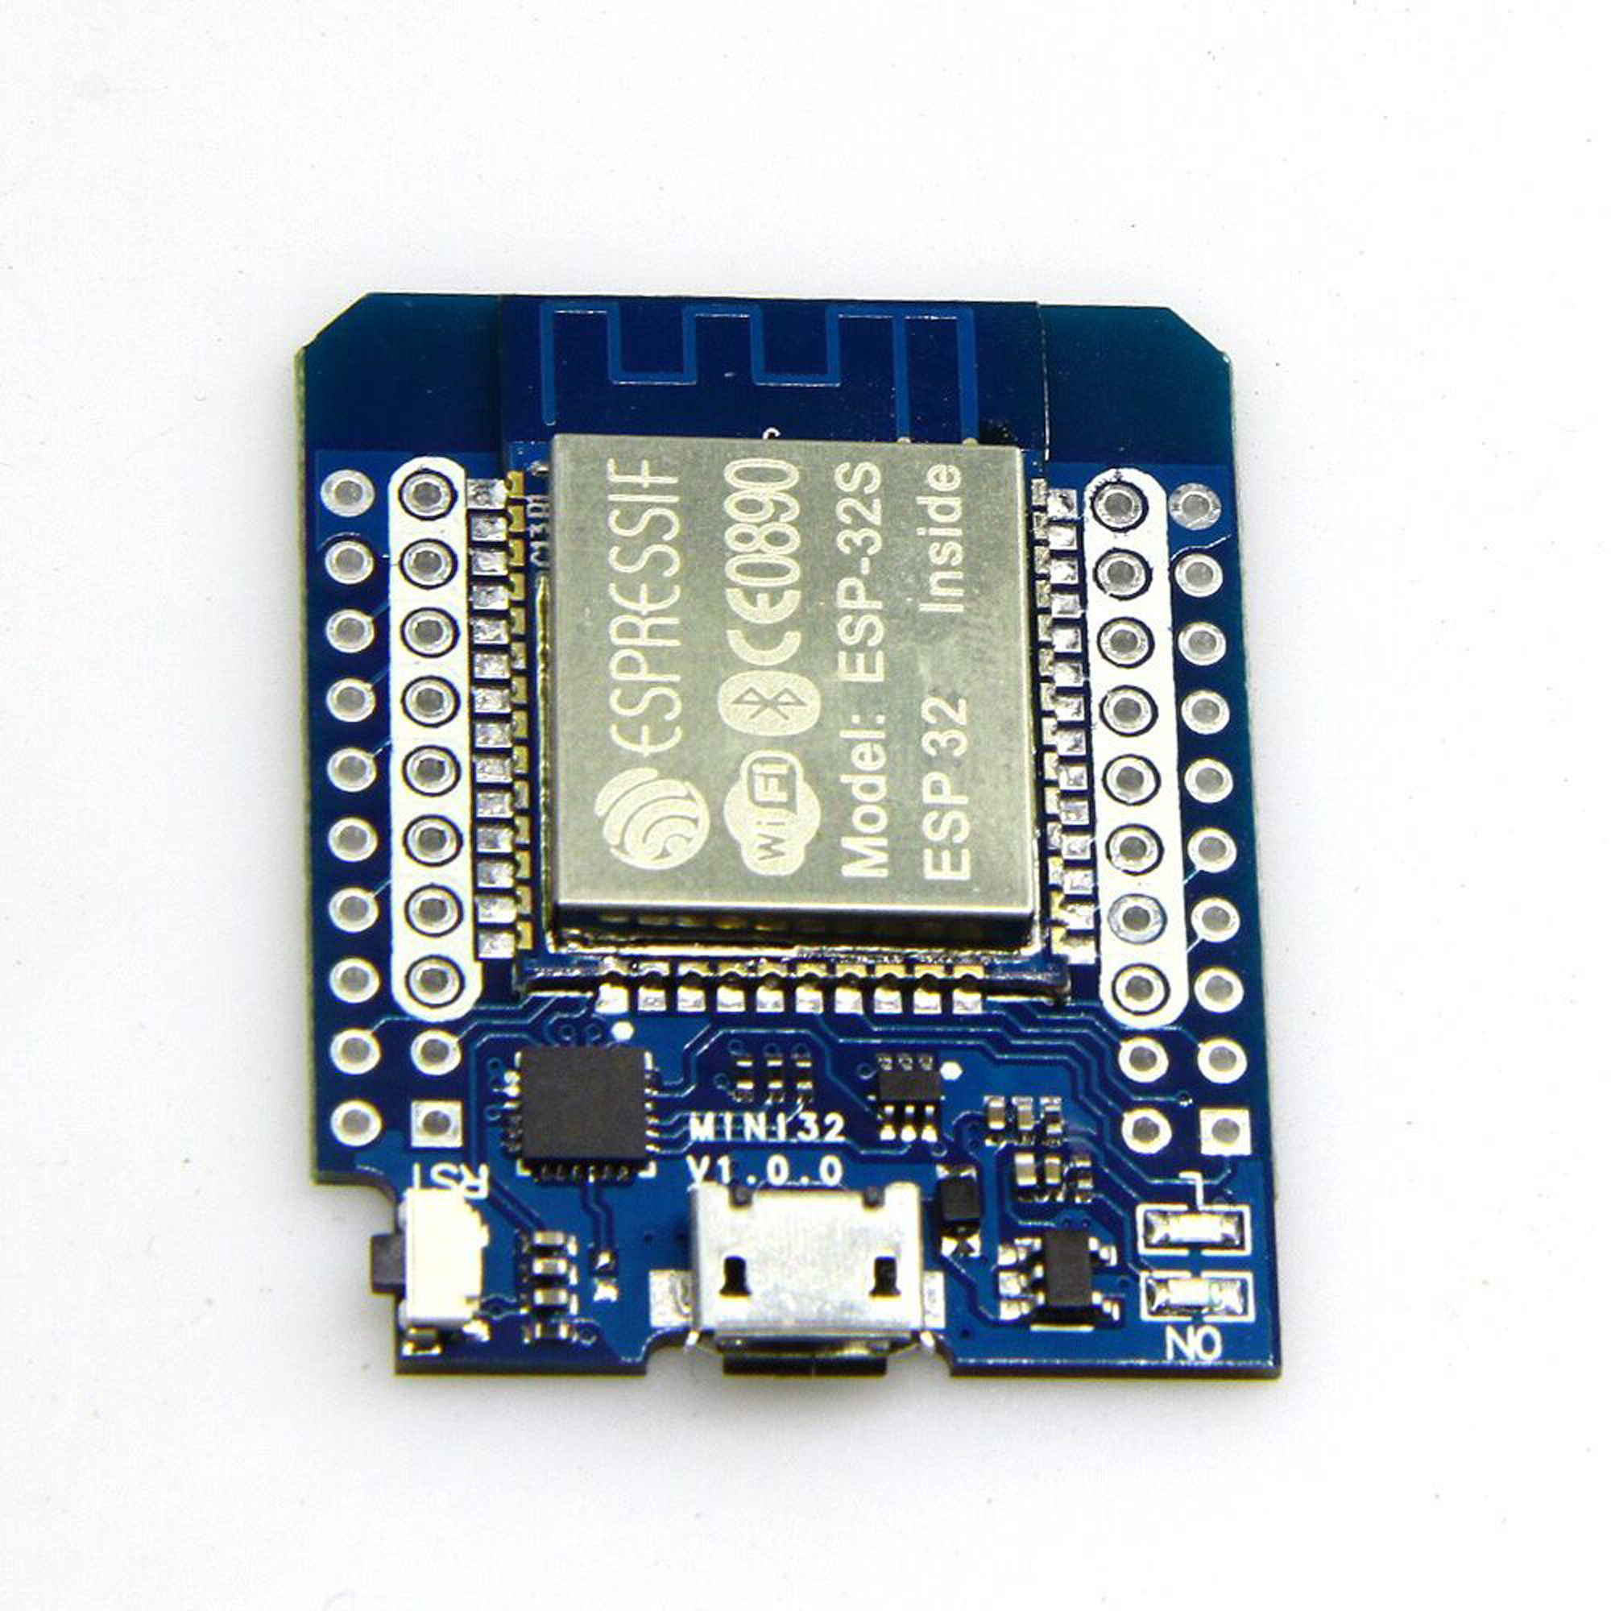
Lets Build a Sensor
ESP8266 Wi-Fi Enables Microprocessor
Programmable with Arduino C++ code
1000s Libraries and examples
11 Digital input
1 Analog input
Required
ESP8266 board manager
PubSubClient Library installed
Dallas Library for TempDemo

Slide 6
NOTES
Handouts

Slide 7
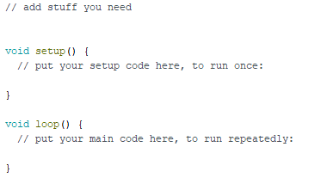
Arduino Coding

Slide 8
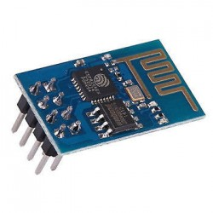
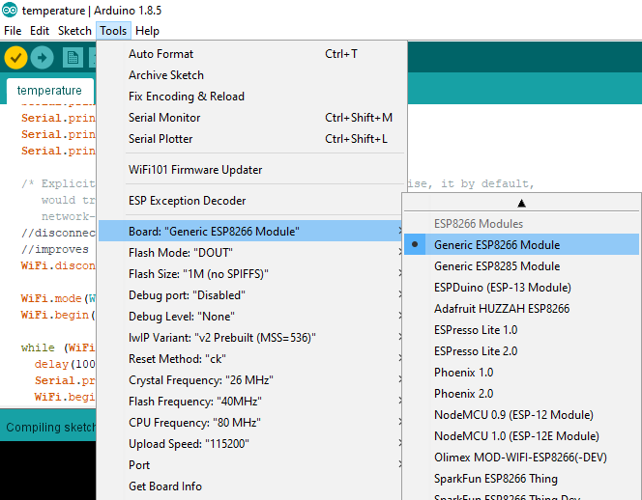
Arduino Coding
Set these options

Slide 9
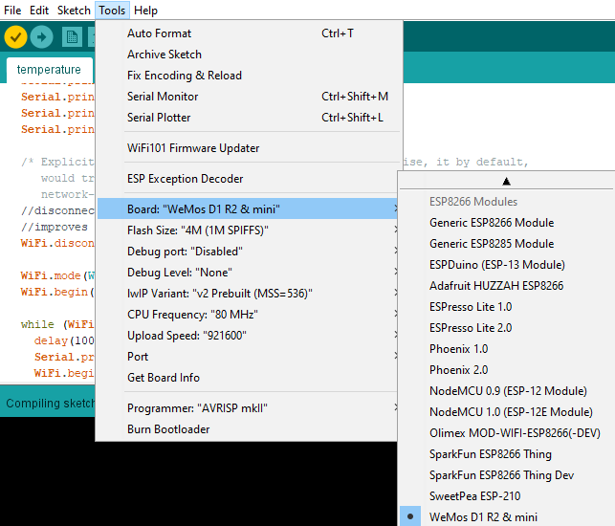
Arduino Coding
Set these options

Slide 10
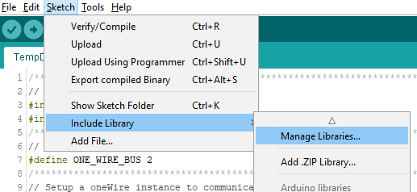
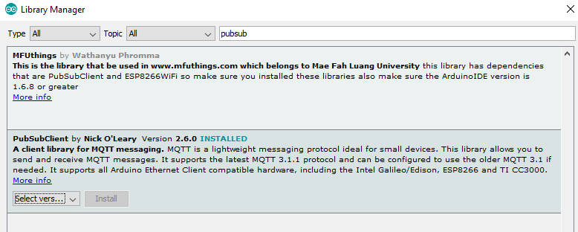
Check you have the pubsubclient library

Slide 11
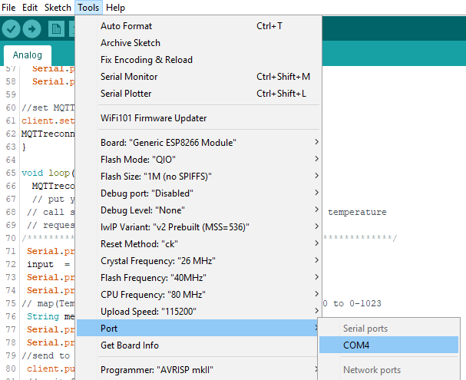
Plugin Device Check Serial Port It may not be COM4

Slide 12
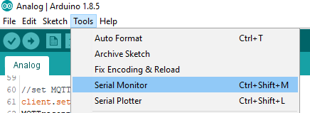
Use Serial Port monitor to see “Serial.print” messages

Slide 13
MQTT Broker from https://cloudmqtt.com/
Server: Broker hostname
User : Broker User Name
Password: Broker Pass
Port: Broker Port
Topics
Dial 1: /control/dial/cmnd/pwm1 (0-1023)
Dial 2: /control/dial/cmnd/pmw2 (0-1023)
Plug: /control/plug/cmnd/power (ON or OFF)
Light: /control/light/cmnd/power (ON or OFF)
Sample Code available from https://github.com/species5618/IOTDEMO

Slide 14
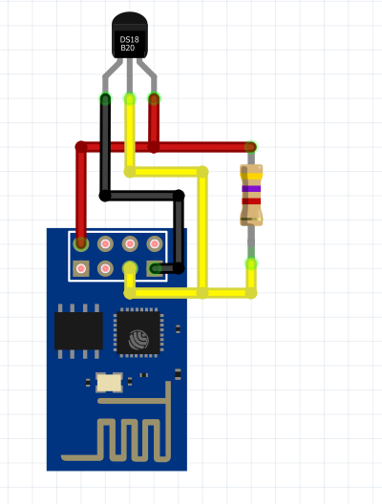
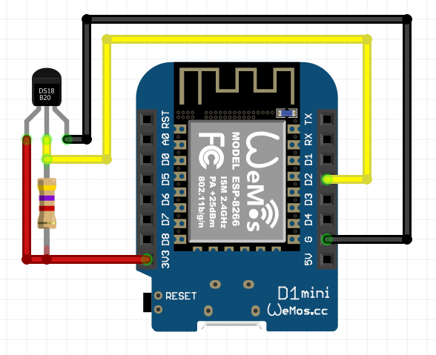
Temperature Sensor (TempDemo)

Slide 15
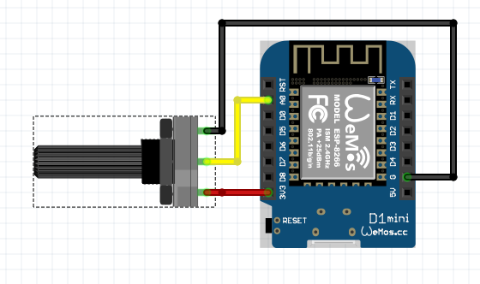
Analog Demo

Slide 16
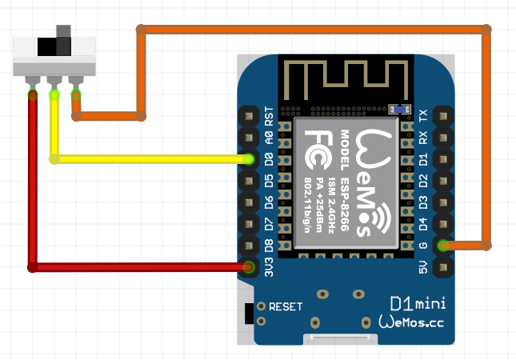
Switch Demo

Slide 17
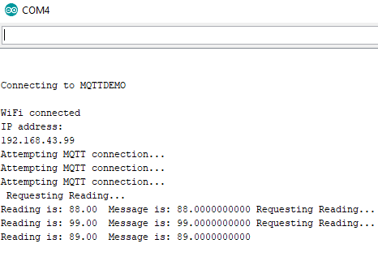
Example Debug message

Slide 18
References
Arduino https://www.arduino.cc/
ESP8266 https://en.wikipedia.org/wiki/ESP8266 https://learn.sparkfun.com/tutorials/esp8266-thing-hookup-guide/installing-the-esp8266-arduino-addon
Demo Source Code https://github.com/species5618/IOTDEMO
Temperature sensor example https://create.arduino.cc/projecthub/TheGadgetBoy/ds18b20-digital-temperature-sensor-and-arduino-9cc806

